Slide 1
The Asset Register Report
The GSM Business Intelligence (BI) tool provides a report of the fixed assets assigned to your location
GSM function required: BI User

Slide 2
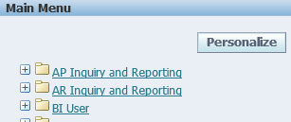
Select: BI User

Slide 3
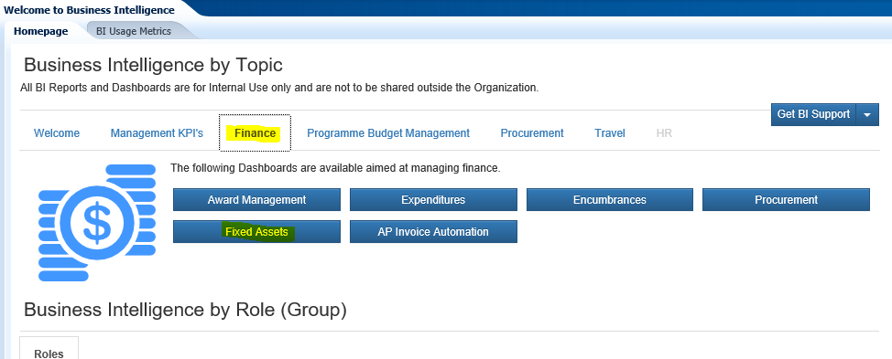
Select Finance
Then select Fixed Assets

Slide 4
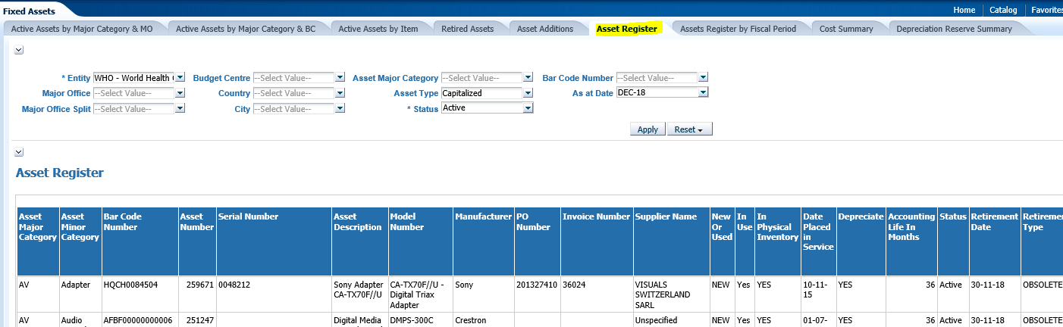
1. Select
Asset Register
2. Then enter the relevant filters
3. Select Apply

Slide 5
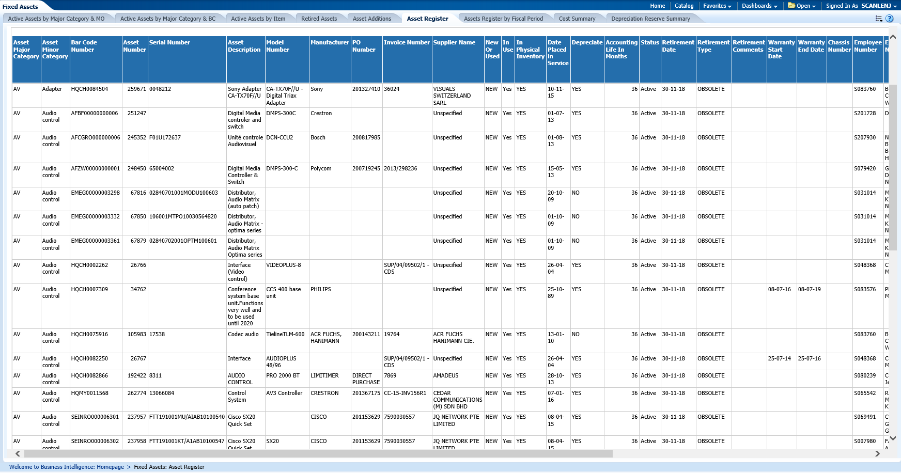
The Result

Slide 6
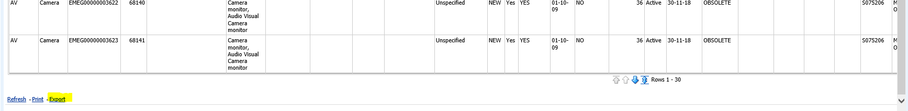
Select Export to obtain this report and convert to excel

Slide 7
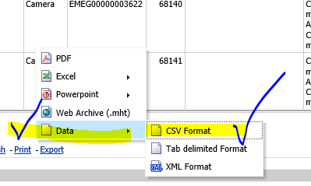
Select DATA. NB: selecting excel will also work but is much slower and does not support filtering
Then CSV format

Slide 8
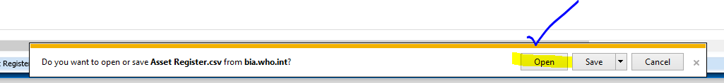
Click Open
Click to Open or Save the file

Slide 9
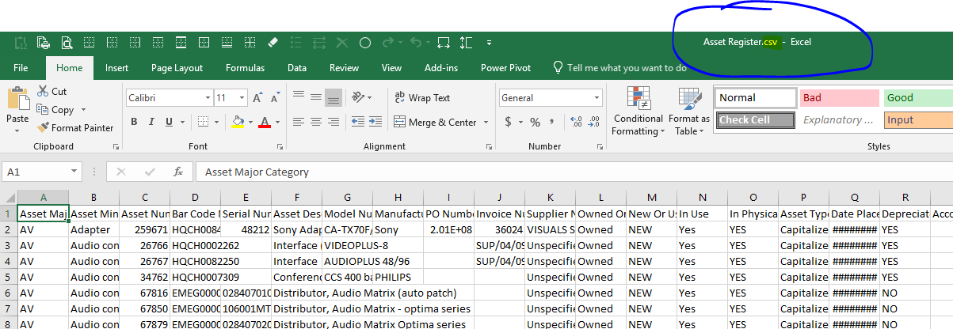
The Report in .csv format opens
Immediately save the report in .xls format e.g. by pressing F12 and selecting the format type

